Slide 1
ENGR 11: Introduction to
Engineering Analysis I
GS 138
Dr. Mandala

Slide 2
Introduction
Spreadsheet is a data storage tool
Stores data in tabular (matrix or table) form
Data stored can be numbers, text (string), or equations
We will use Microsoft Excel
Spreadsheet tool
Free to Pitt students

Slide 3
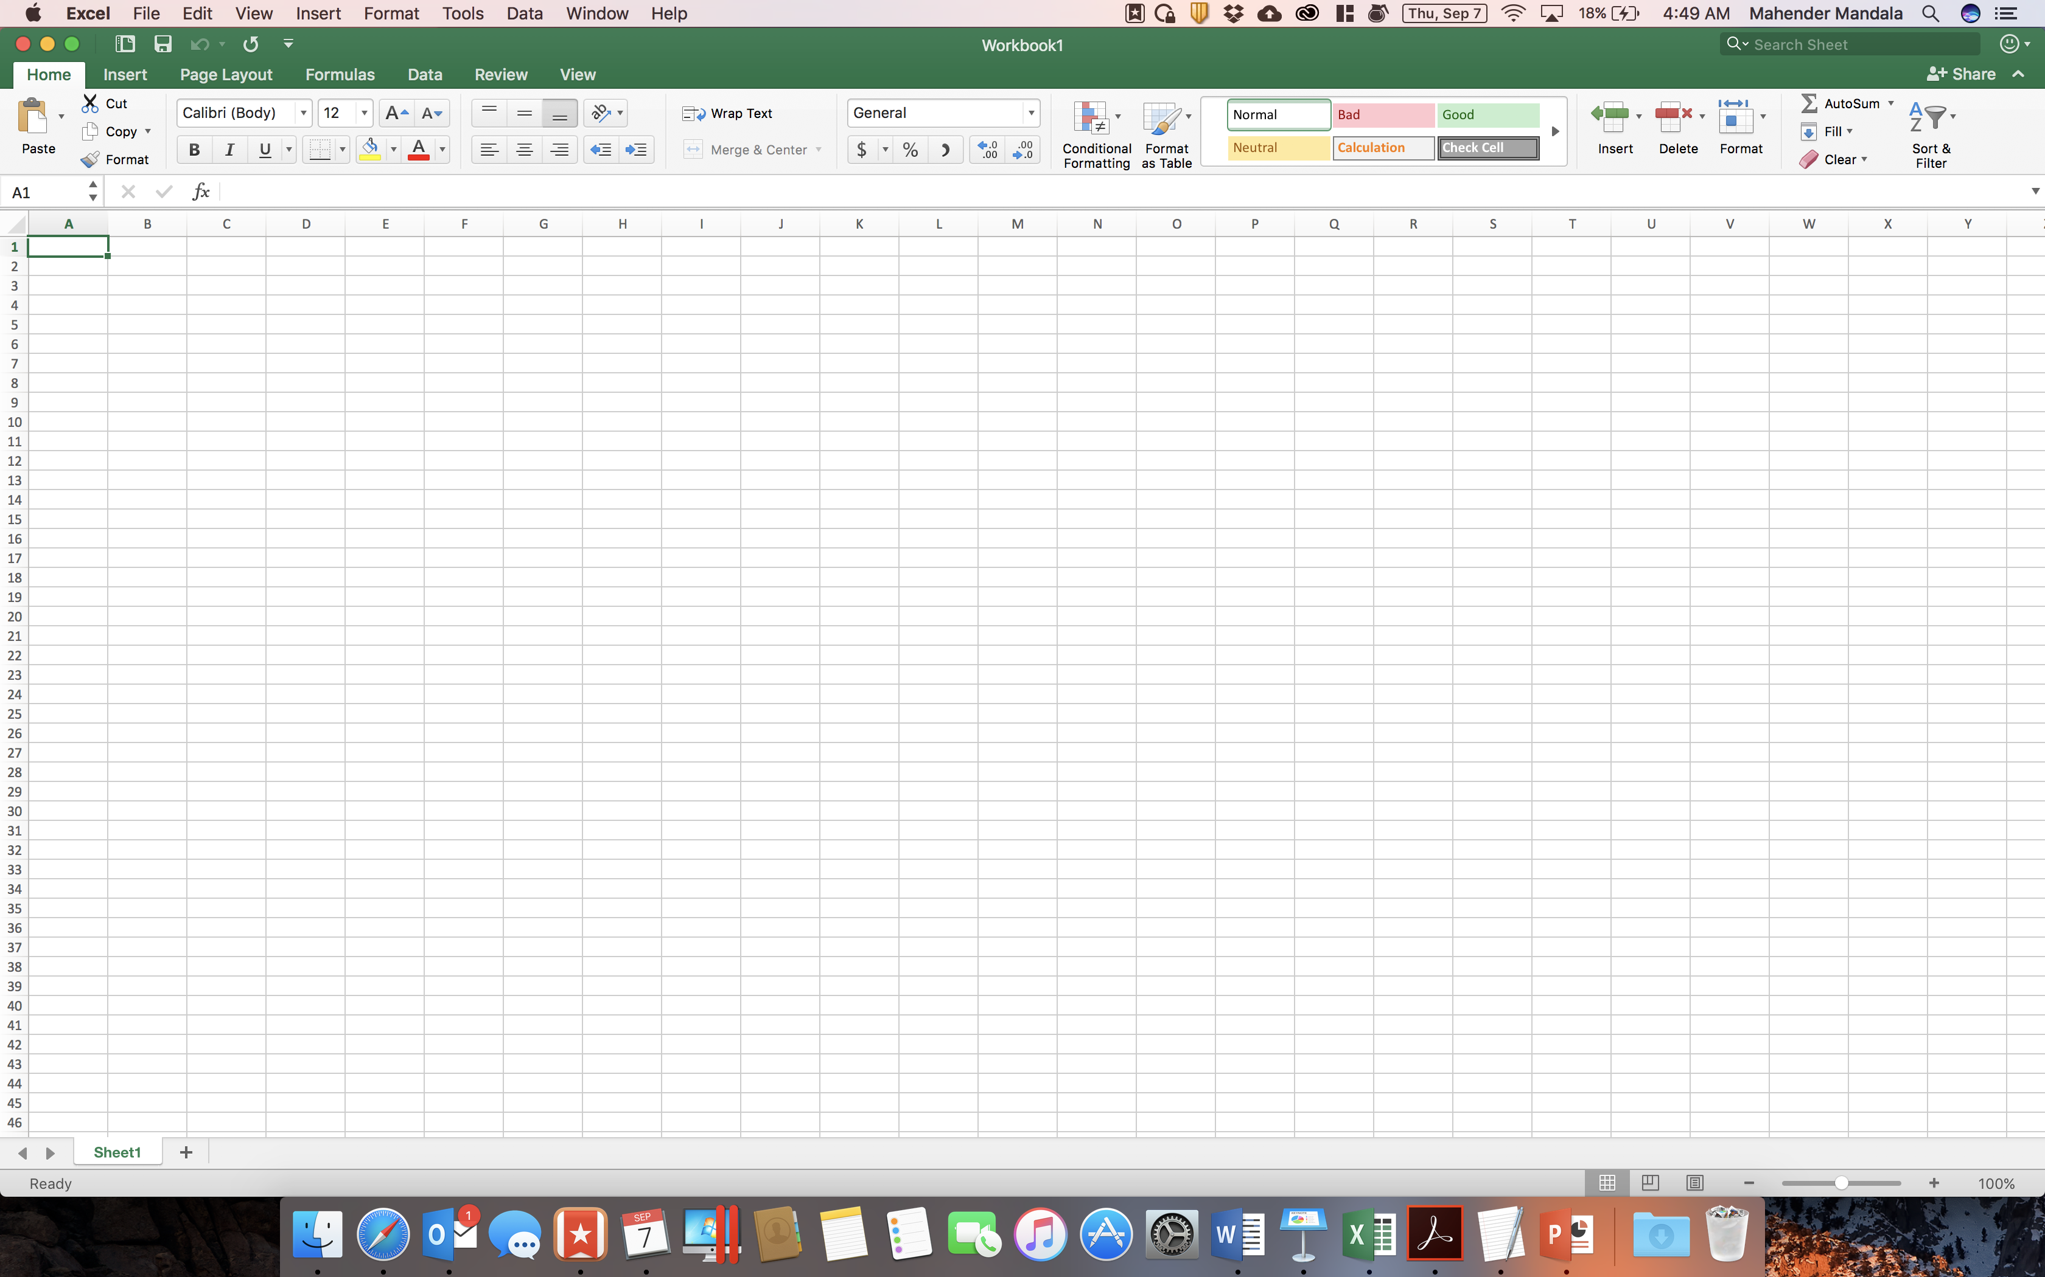
Excel (macos 2016)
Quick access toolbar
Address box
Menu bar
Cell
Entry (data) type
Edit line or formula bar
Spreadsheet Data Area
Worksheet

Slide 4
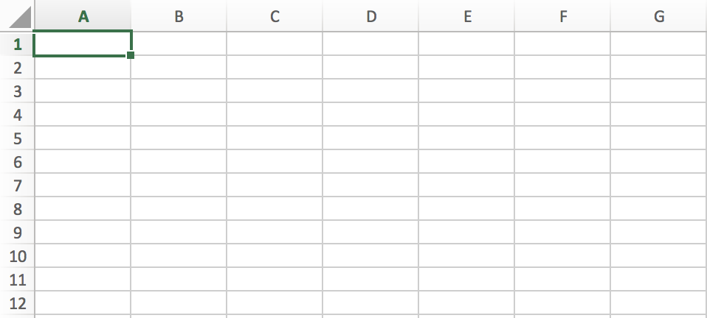
EXCel data address
Cell Address:
[column letter][row number]
e.g. A1, B12, G2 etc.
Active Cell:
Cell clicked on (with green box)

Slide 5
EXCel data address
Relative Address (default):
No dollar ($) sign: A1, B12 etc.
Absolute Address:
Cell address with dollar sign ($): $A$1, $A1, B$2
$ fixes a part of the address

Slide 6
Excel operations
Default: cell contains data
Cell operation: first character of cell is ‘=’
Tells excel: in this cell display output of the operation after =
= A1+B22
= A1*24
= (A1+B2 +B5)/(N56)*234 – 4*A33
= A1&A2

Slide 7
Relative versus absolute addressing
A
B
C
D
E
1
2
3
4
5

Slide 8
Relative versus absolute addressing
A
B
C
D
E
 | ? |  | =E4
1
2
3
4
5

Slide 9
Relative versus absolute addressing
A
B
C
D
E
 | =C4 |  | =E4
1
2
3
4
5

Slide 10
Relative versus absolute addressing
A
B
C
D
E
 | ?
 |  |  | =E4
1
2
3
4
5

Slide 11
Relative versus absolute addressing
A
B
C
D
E
 | =C2
 |  |  | =E4
1
2
3
4
5

Slide 12
Relative versus absolute addressing
A
B
C
D
E
 | ? |  | =$E4
1
2
3
4
5

Slide 13
Relative versus absolute addressing
A
B
C
D
E
 | =$E4 |  | =$E4
1
2
3
4
5

Slide 14
Relative versus absolute addressing
A
B
C
D
E
 | ?
 |  |  | =$E4
1
2
3
4
5

Slide 15
Relative versus absolute addressing
A
B
C
D
E
 | =$E2
 |  |  | =$E4
1
2
3
4
5

Slide 16
Relative versus absolute addressing
A
B
C
D
E
 | ? |  | =E$4
1
2
3
4
5

Slide 17
Relative versus absolute addressing
A
B
C
D
E
 | =C$4 |  | =E$4
1
2
3
4
5

Slide 18
Relative versus absolute addressing
A
B
C
D
E
 | ?
 |  |  | =E$4
1
2
3
4
5

Slide 19
Relative versus absolute addressing
A
B
C
D
E
 | =C$4
 |  |  | =E$4
1
2
3
4
5

Slide 20
Operator Precedence
How does excel solve math:
First it applies any negation if present: -3 or -5 etc.
Second, it applies exponentiation: 4² or 7³ (written as 4^2 or 7^3 respectively)
Third, it performs multiplication and division from left to right.
Fourth, it performs addition and subtraction from left to right.
How do you change the order?
Enclose operation within parentheses ()
1-4^3 + 9*3 = ??
(1-4)^3+9*3 = ??
Notes:
-36
0

Slide 21
In class activity
Download Excel-1 handbook from courseweb
Download Gradebook.xlsx from courseweb
Download Grades.txt from courseweb

Slide 22
acknowledgment
Based on work by Prof. Arash Mahboobin

